Slide 1

Fast Organized Patient Record Manager
Authors:
Vinh Mai
Philip Dube

Slide 2
Introduction:
Foprm, ‘Fast Organised Patient Records Manager”, is a fast, organized and beginner friendly application with some most useful features such as creating view, update and post profiles much easier than dealing with papers helping to improve the work speed.

Slide 3
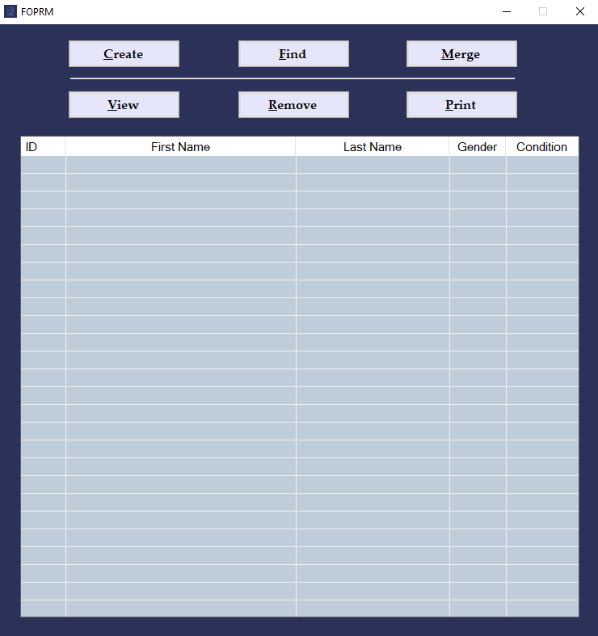
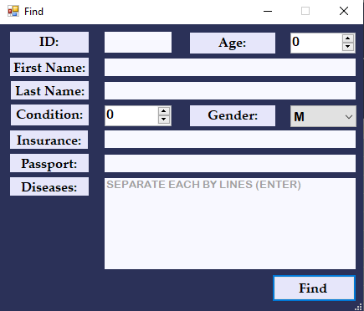
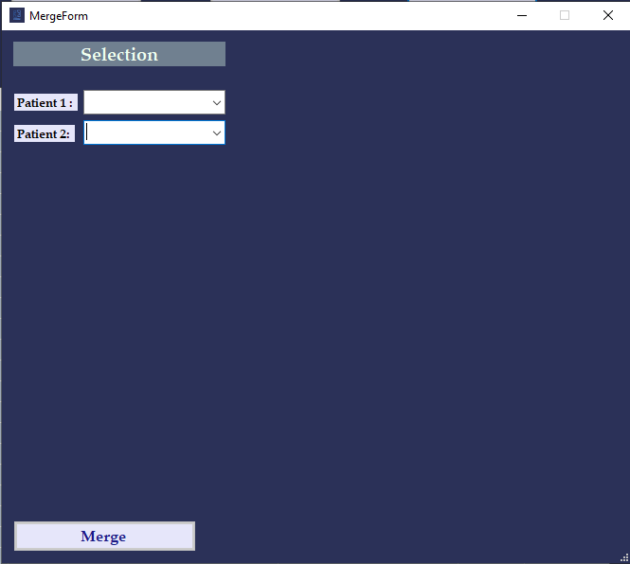
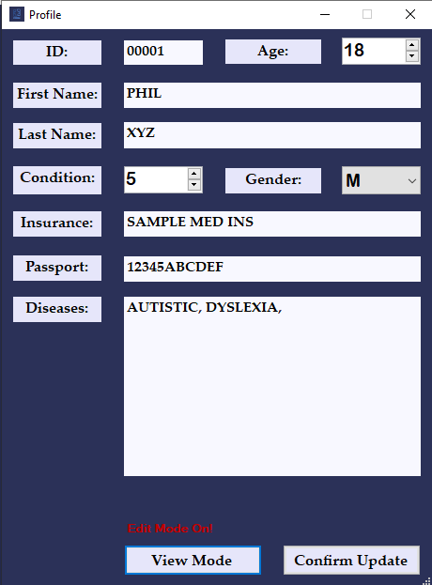
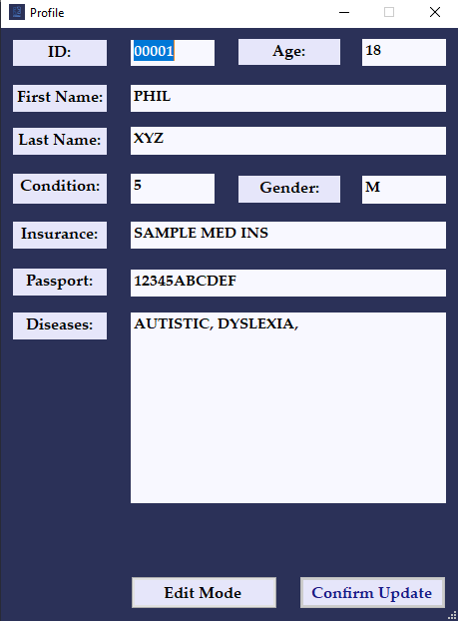
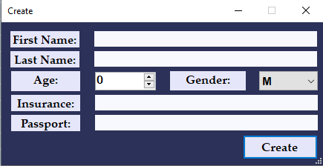
Workplaces
Friendly GUI
Beginner Friendly

Slide 4

Features
Create
Search/Find
Merge
View
Remove
Print & Print board
Sort
Refresh

Slide 5
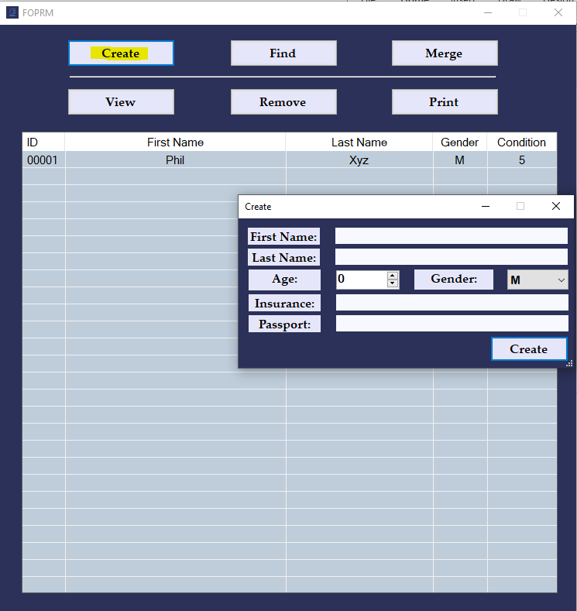
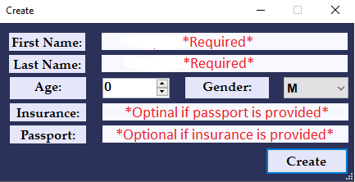
Create Feature:

Slide 6
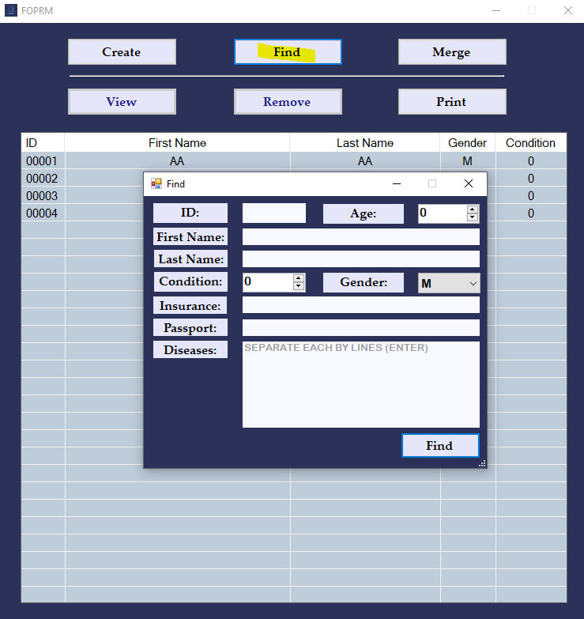
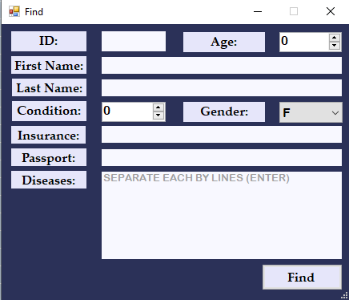
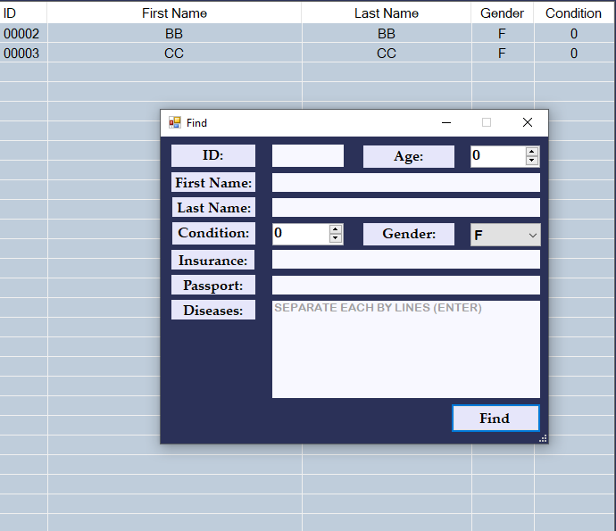
Search/Find Features
Input information of wanted record

Slide 7
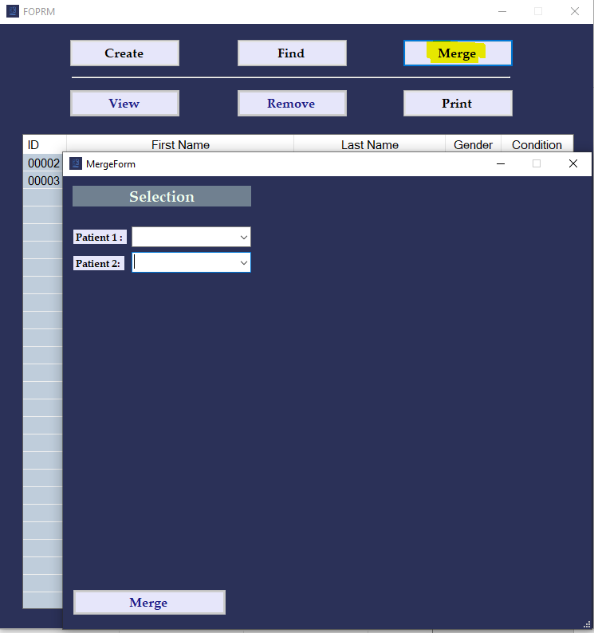
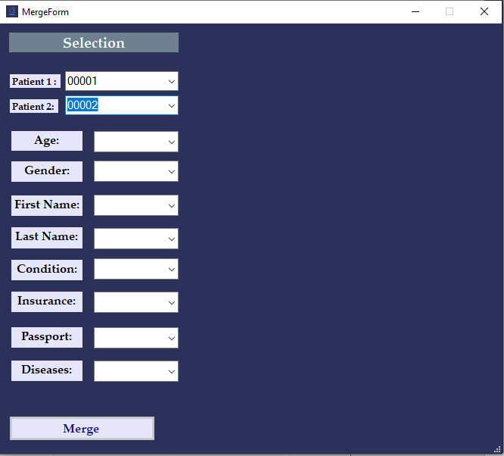
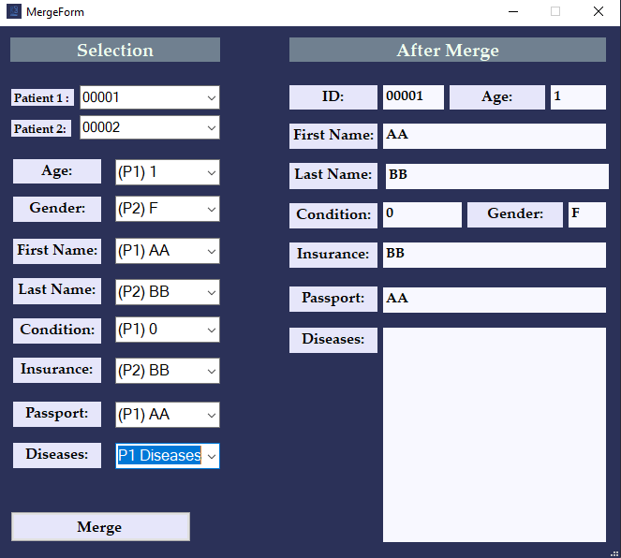
Merge Feature:
Select 2 records
Select to keep information
Click merge if satisfied

Slide 8
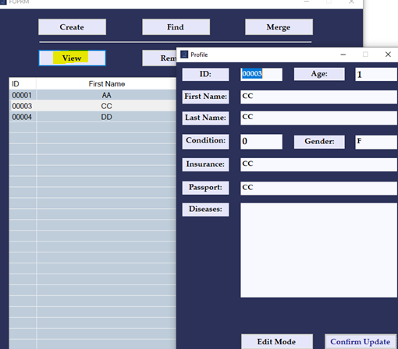
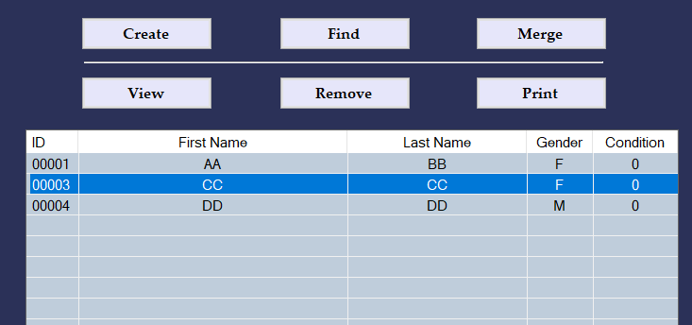
View Feature:

Slide 9
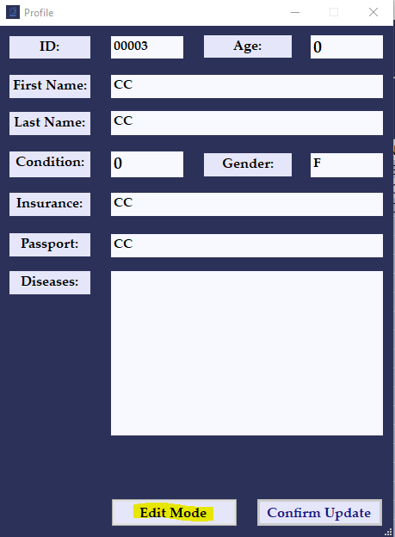
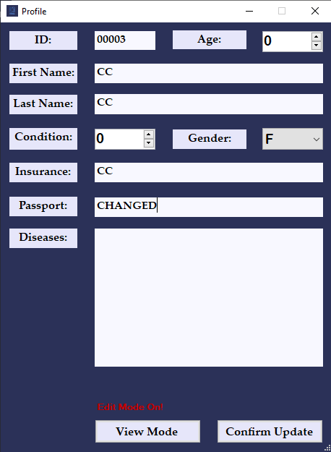
Edit/Update Feature:

Slide 10
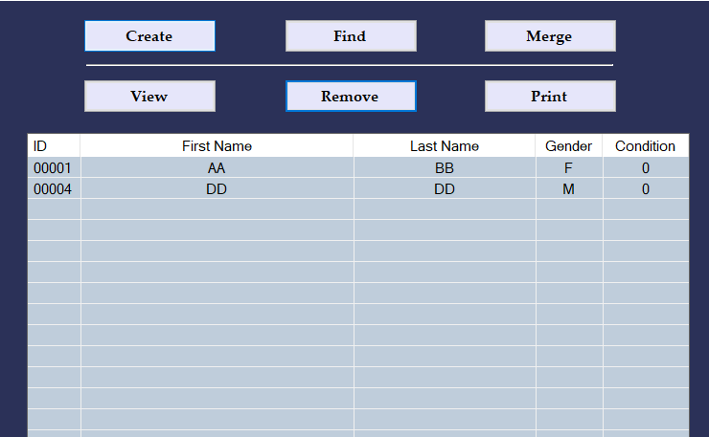
Remove Feature:

Slide 11
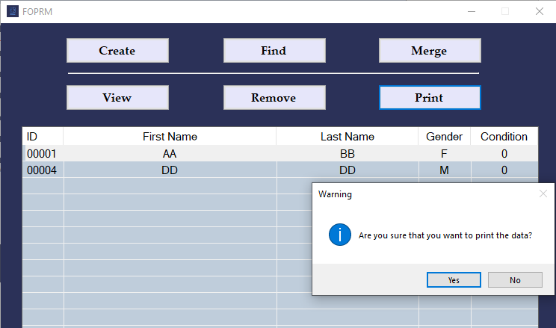
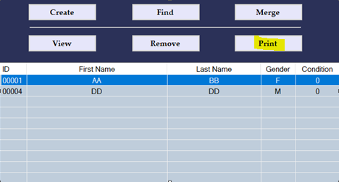
Print record-s Feature:

Slide 12
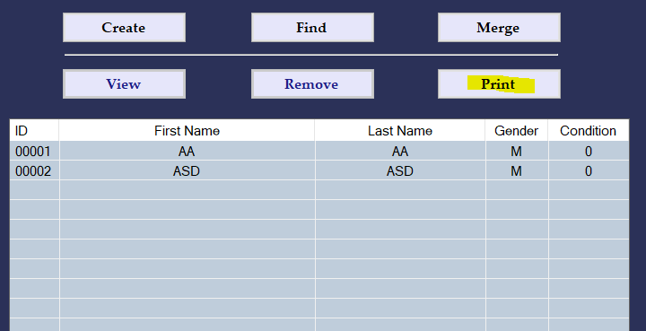
Print Board Feature:
Click Print without any record selected

Slide 13
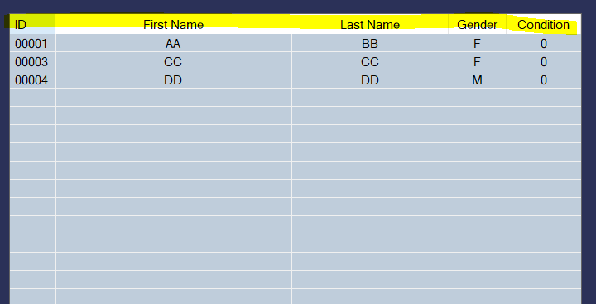
Sort Feature:
Sort Ascending/Descending by click the header (ID, First Name, Last Name, Gender, Condition)

Slide 14
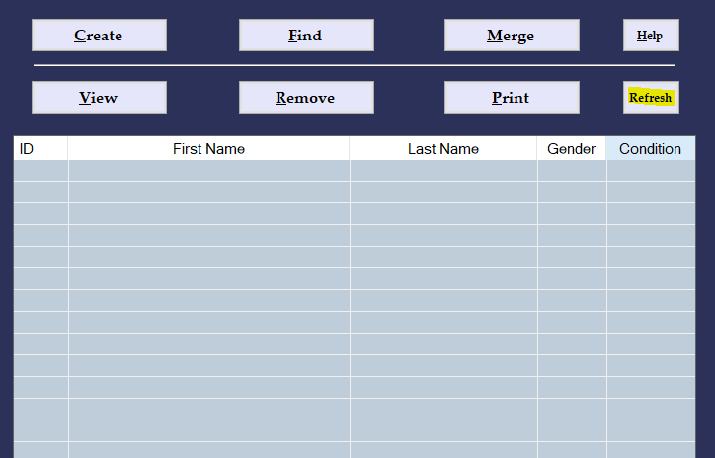
Refresh Feature (Refresh board):
Use “Refresh” button or press “F5” to refresh the board after finished with Sort/Find.

Slide 15
-Thank you for using our product -
Authors: Vinh Mai - Philip Dube

